Slide 1

Text here
Text here
Policy, strategy and operational solutions for Governments and businesses
Text here
www.universal-defence.com

Slide 2


Slide 3
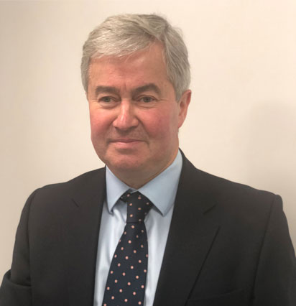
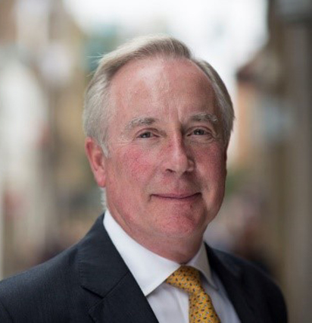
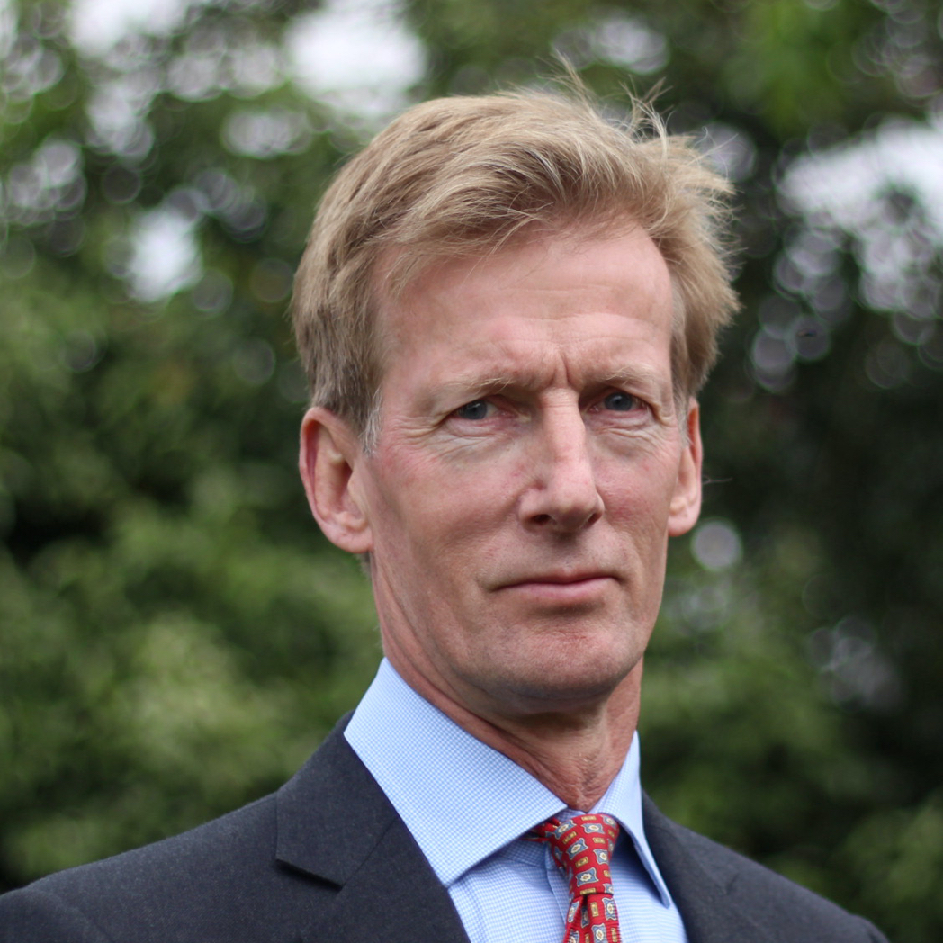
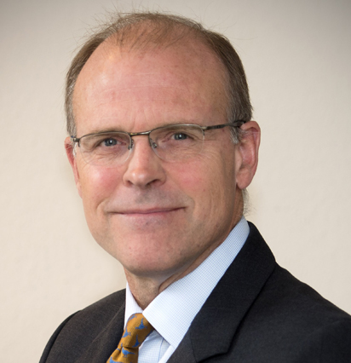
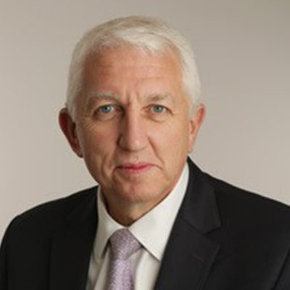
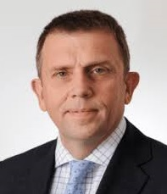
The UDSS Directors bring unique experience and capability
General Sir Richard Barrons KCB CBE
(Co-Chairman)
Former Commander, Joint Forces Command
Peter L R Hewitt JP, FCSI, FRSA
(Co-Chairman)
City entrepreneur – 13 public companies
Lt Gen (Retd) Sir Mark Poffley KCB OBE (Director)
Former National Armaments Director
Vice Admiral (Retd) Duncan L Potts CB (Director)
Former Assistant Chief of Naval Staff, Capability
Air Marshal (Retd) Phil Osborn CBE FRAeS
(Director)
Former Chief of Defence Intelligence
Maj Gen (Retd) David Shouesmith
(Director)
Former Assistant Chief of Defence Staff, Logistic Operations

Slide 5
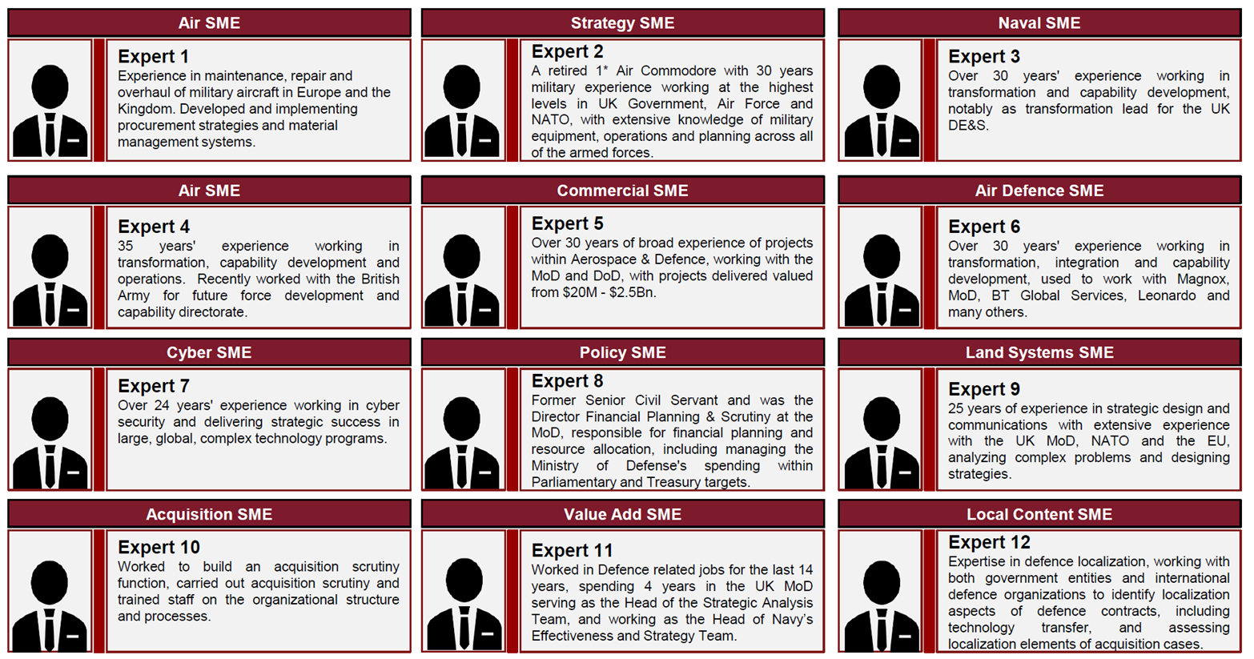
UDSS provides senior advisors and junior advisors - example SMEs for a recent overseas acquisition & procurement project

Slide 6
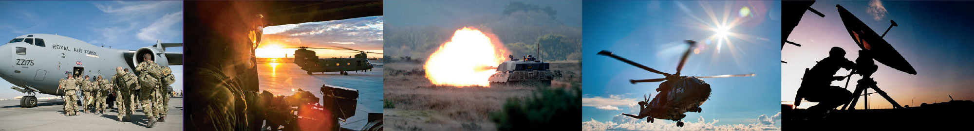
Questions/Discussion
9

Slide 7

Office Address: Fourth Floor, 33 Cannon St, London EC4M 5SB
Office Tel: 020 7199 4155
Contacts
Maj Gen (Retd) David Shouesmith
Email: david.shouesmith@universal-defence.com Mob: 07545 387378
Peter Hewitt (Co-Chairman)
Email: peter.hewitt@universal-defence.com Mob: 07710 908816

